Slide 2
objectives
Use digital color histograms to segment regions of interest in an image.
Compare the strengths and limitations of three segmentation techniques.
Explore how these segmentation techniques have practical applications.
result 1
result 2
Physics-301/Activity 1 - Color Segmentation.ipynb at main · reneprincipejr/Physics-301 (github.com)
https://drive.google.com/file/d/10yAmcNsyWs8dfkm6fHbPrnsFiF5YHBX9/view?usp=sharing

Slide 3
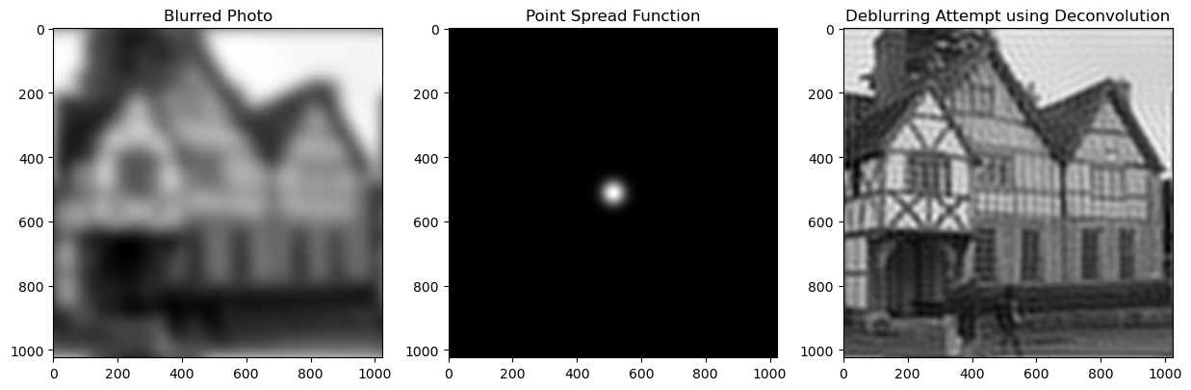
Background
Deblurring a photo works like magic but it in fact involves a lot of physics. Shown below is an image deconvolution technique that exploits a known smearing effect or mathematically known as the point spread function (PSF). The original image appears blurry, as if it is smeared in all directions. Hence, a gaussian distribution function can be deciphered as the blurred photo’s PSF. Upon implementing deconvolution in the fourier space, the image reconstructed is much clearer and sharper. Deblurring using deconvolution can be used to improve the low-quality of images, with practical applications to identify a person’s face or letterings from license plates.
Notes:
You've probably seen it on TV, in one of those crime drama shows. They have a blurry photo of a crime scene and they click a few buttons on the computer and magically the photo becomes sharp and clear, so you can make out someone's face, or some lettering on a sign. Surely (like almost everything else on such TV shows) this is just science fiction? Actually, no. It's not. It's real and in this exercise you'll write a program that does it.

Slide 4
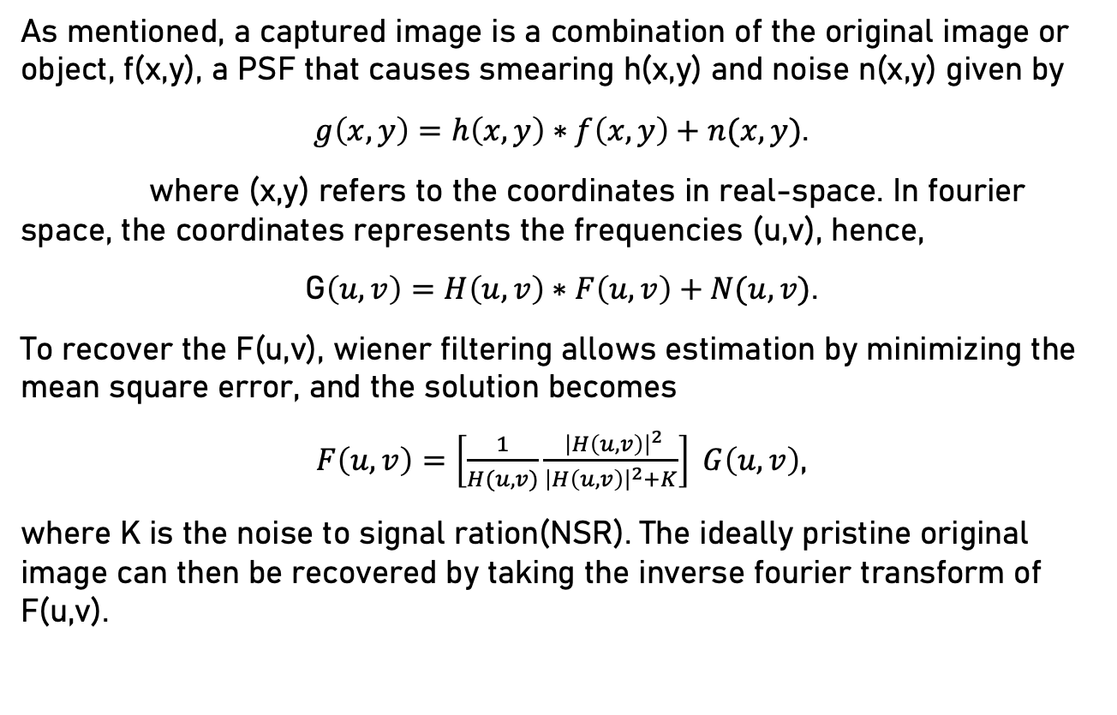
Super-Resolution
As mentioned, a captured image is a combination of the original image or object, f(x,y), a PSF that causes smearing h(x,y) and noise n(x,y) given by
$g\left(x,y\right)=h\left(x,y\right)∗f\left(x,y\right)+n(x,y)$.
where (x,y) refers to the coordinates in real-space. In fourier space, the coordinates represents the frequencies (u,v), hence,
G$\left(u,v\right)=H\left(u,v\right)∗F\left(u,v\right)+N(u,v)$.
To recover the F(u,v), wiener filtering allows estimation by minimizing the mean square error, and the solution becomes
$F\left(u,v\right)=\left[\frac{1}{H(u,v)}\frac{ {\left|H\left(u,v\right)\right|}^{2}}{{\left|H\left(u,v\right)\right|}^{2}+K}\right] G\left(u,v\right)$,
where K is the noise to signal ration(NSR). The ideally pristine original image can then be recovered by taking the inverse fourier transform of F(u,v).

Slide 5
Method
In this activity, blurring kernels of varying orientation and extent were applied as well as increasing degrees of NSR were applied synthetically to a test image. Reconstruction of the original image was carried out using skimage.restoration and fourier deconvolution on Python. The reconstruction accuracy given the blurring parameters was quantified using Structure Simimilarity Index (SSIM). In the end, a moving car’s blurring parameters such as motion direction and pixel extent were estimated in an attempt to super resolve its quality and decipher the text.

Slide 6
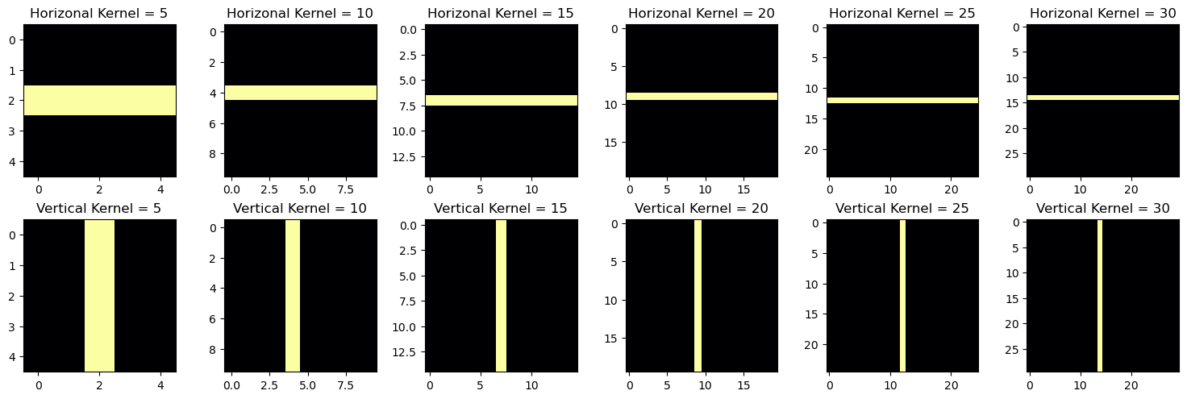
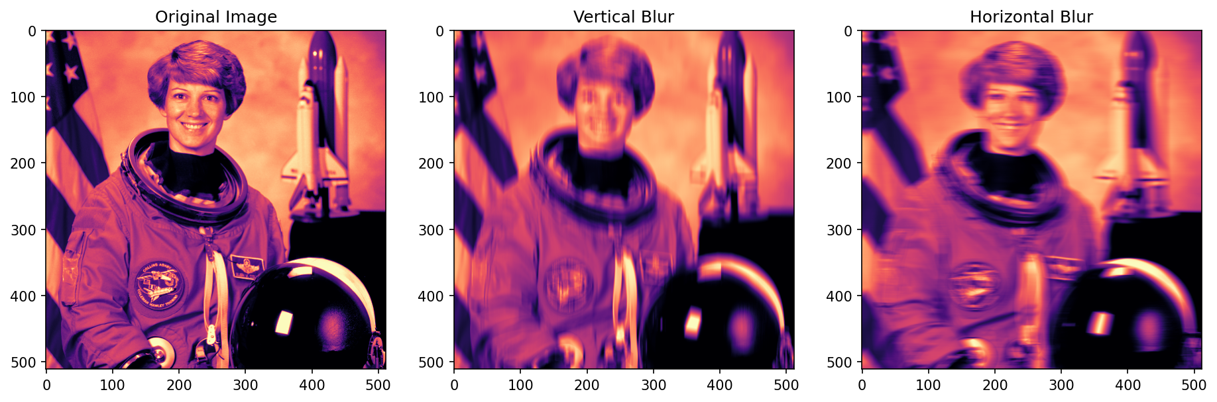
Synthetic kernel blurring

Slide 7
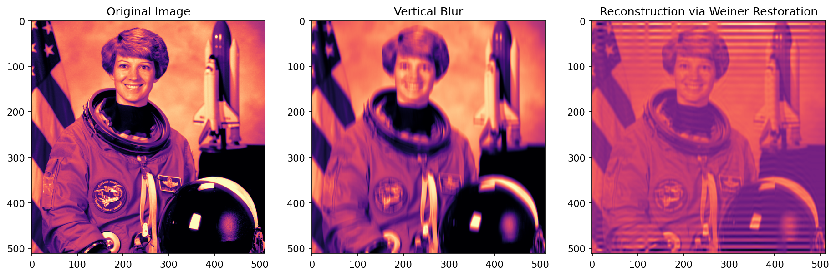
Weiner Restoration
Upon applying the synthetic blur, the image is restored through Weiner estimation technique. As observed,

Slide 8
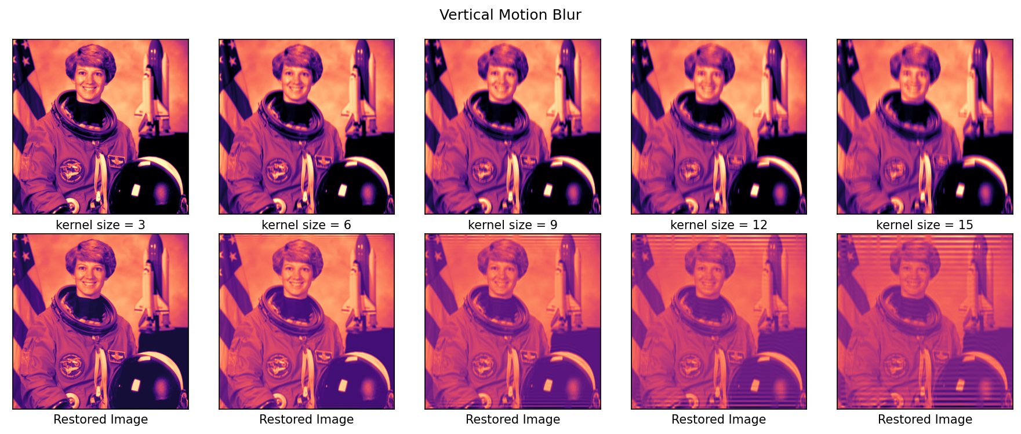
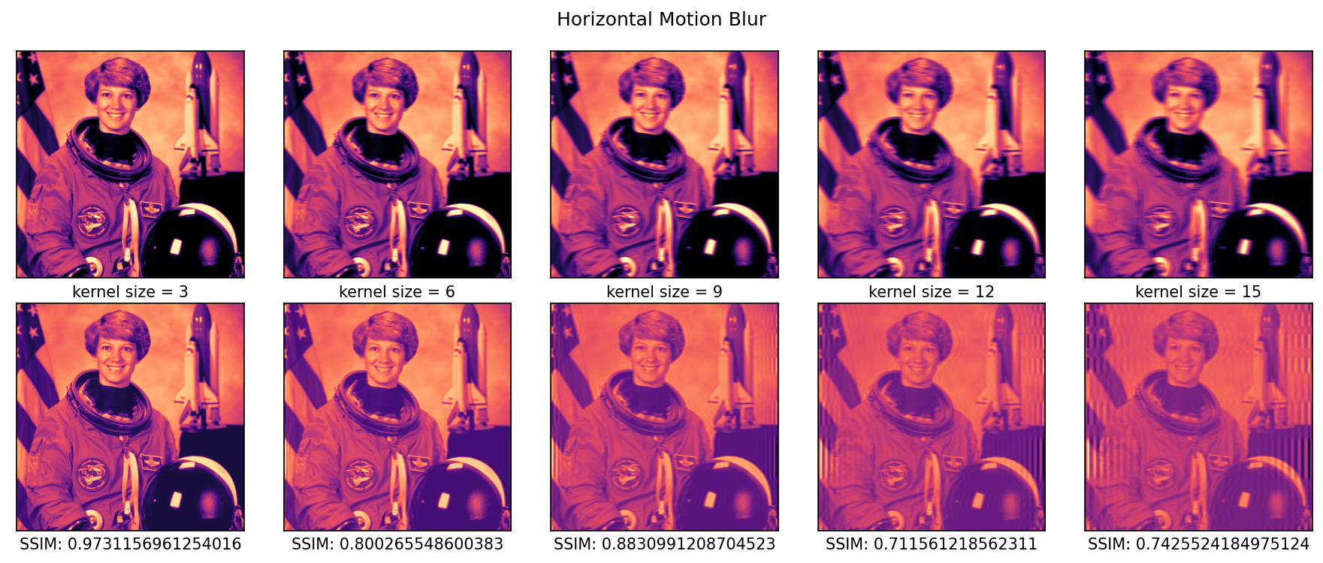

Slide 9
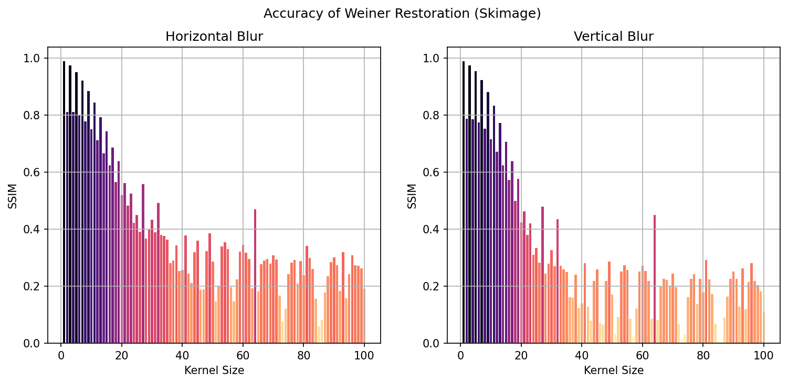
Results - Weiner

Slide 10
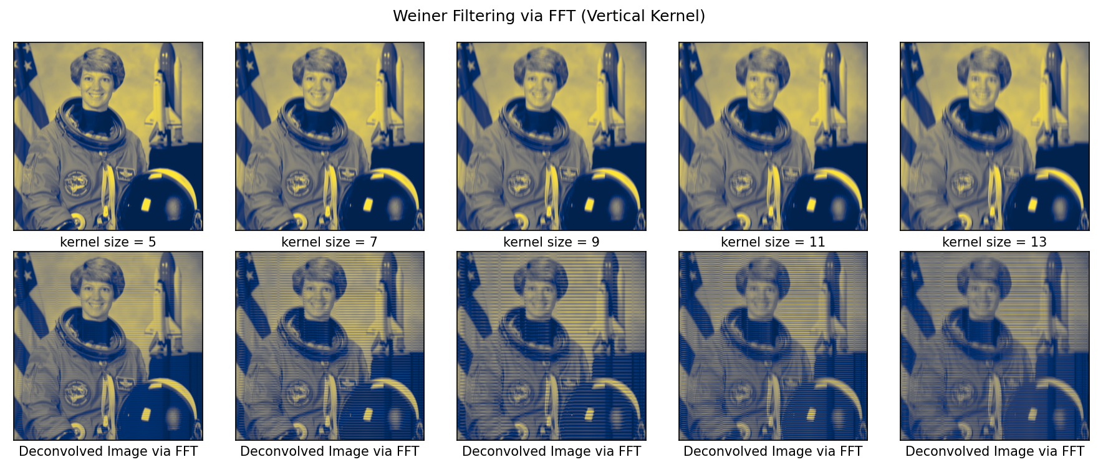
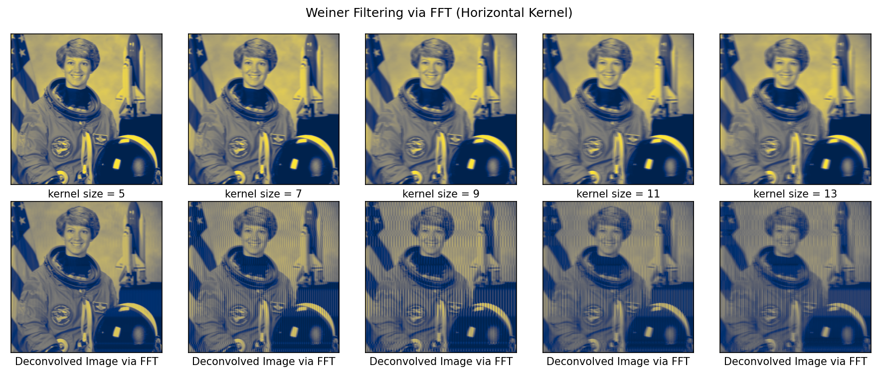

Slide 11
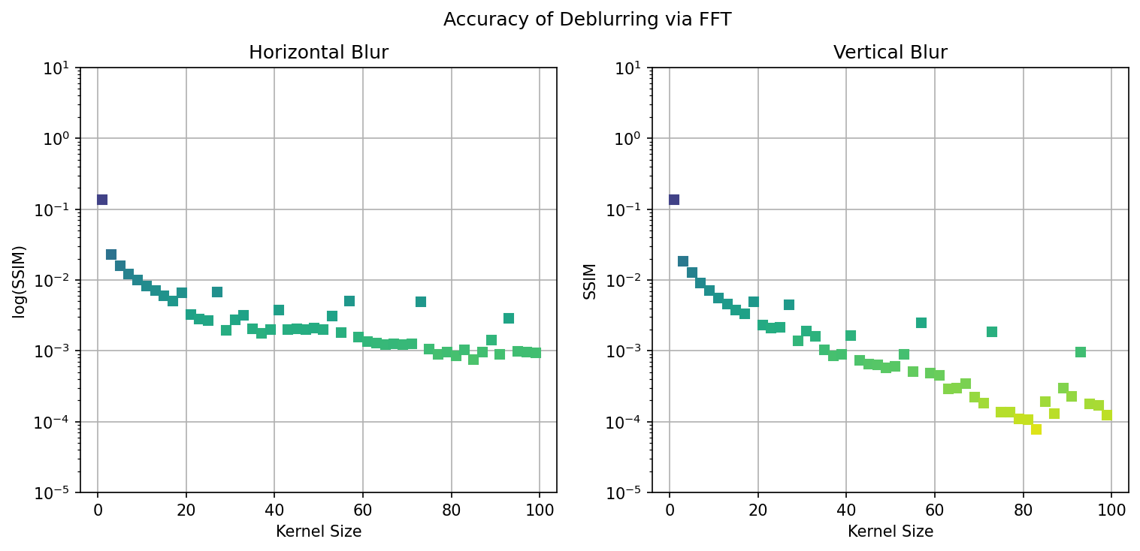
Results - FFT

Slide 12
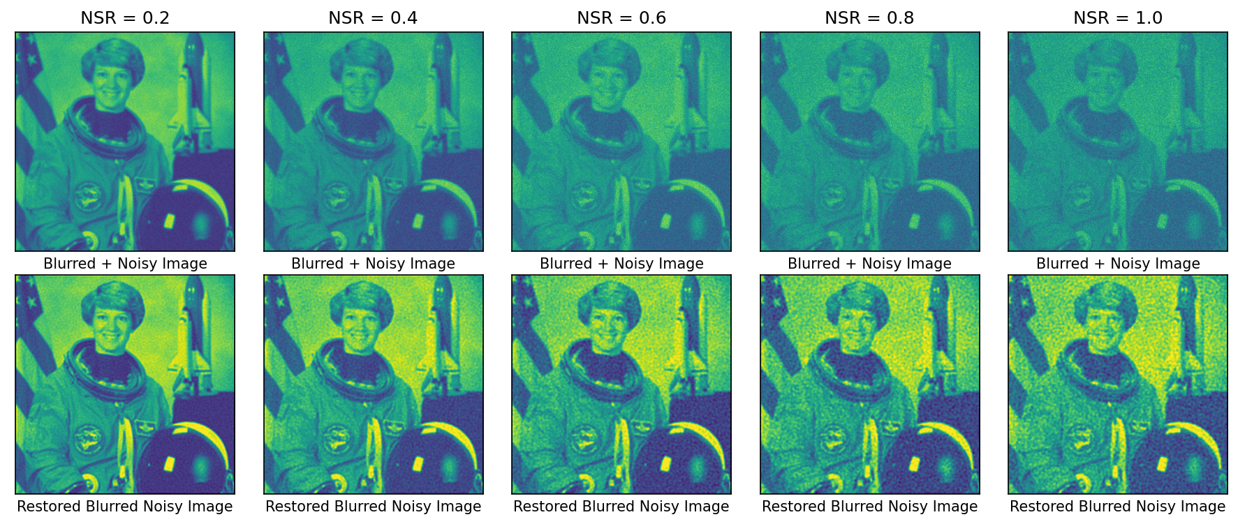
NSR Variation

Slide 13
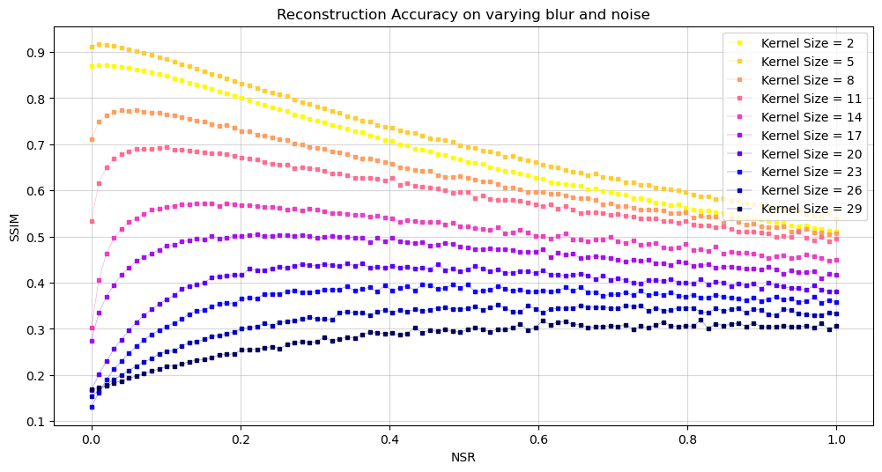

Slide 14
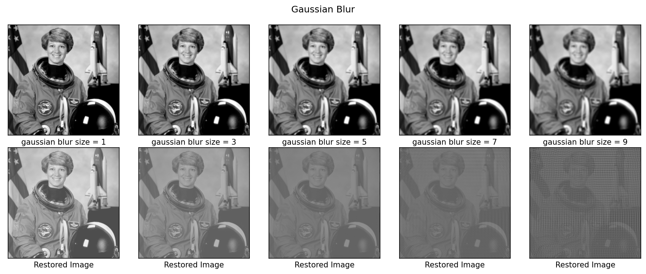
Gaussian Blur

Slide 15
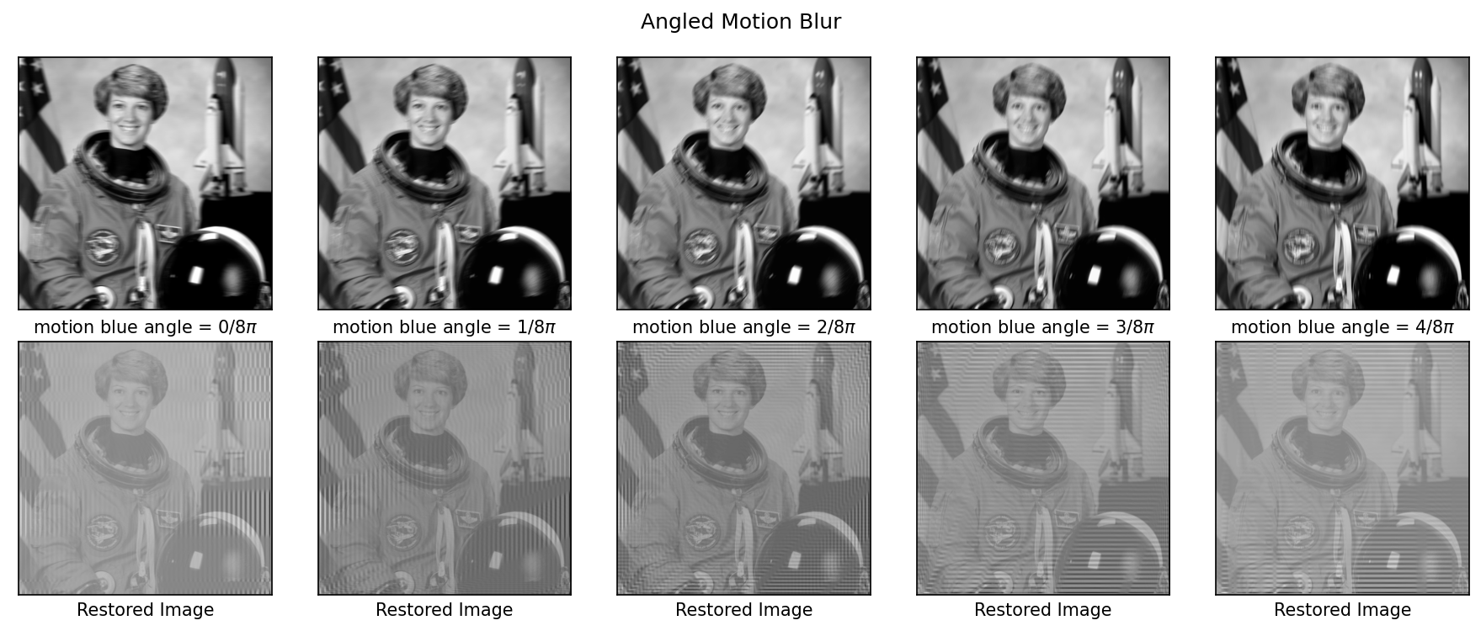
Angular Motion Blur

Slide 16
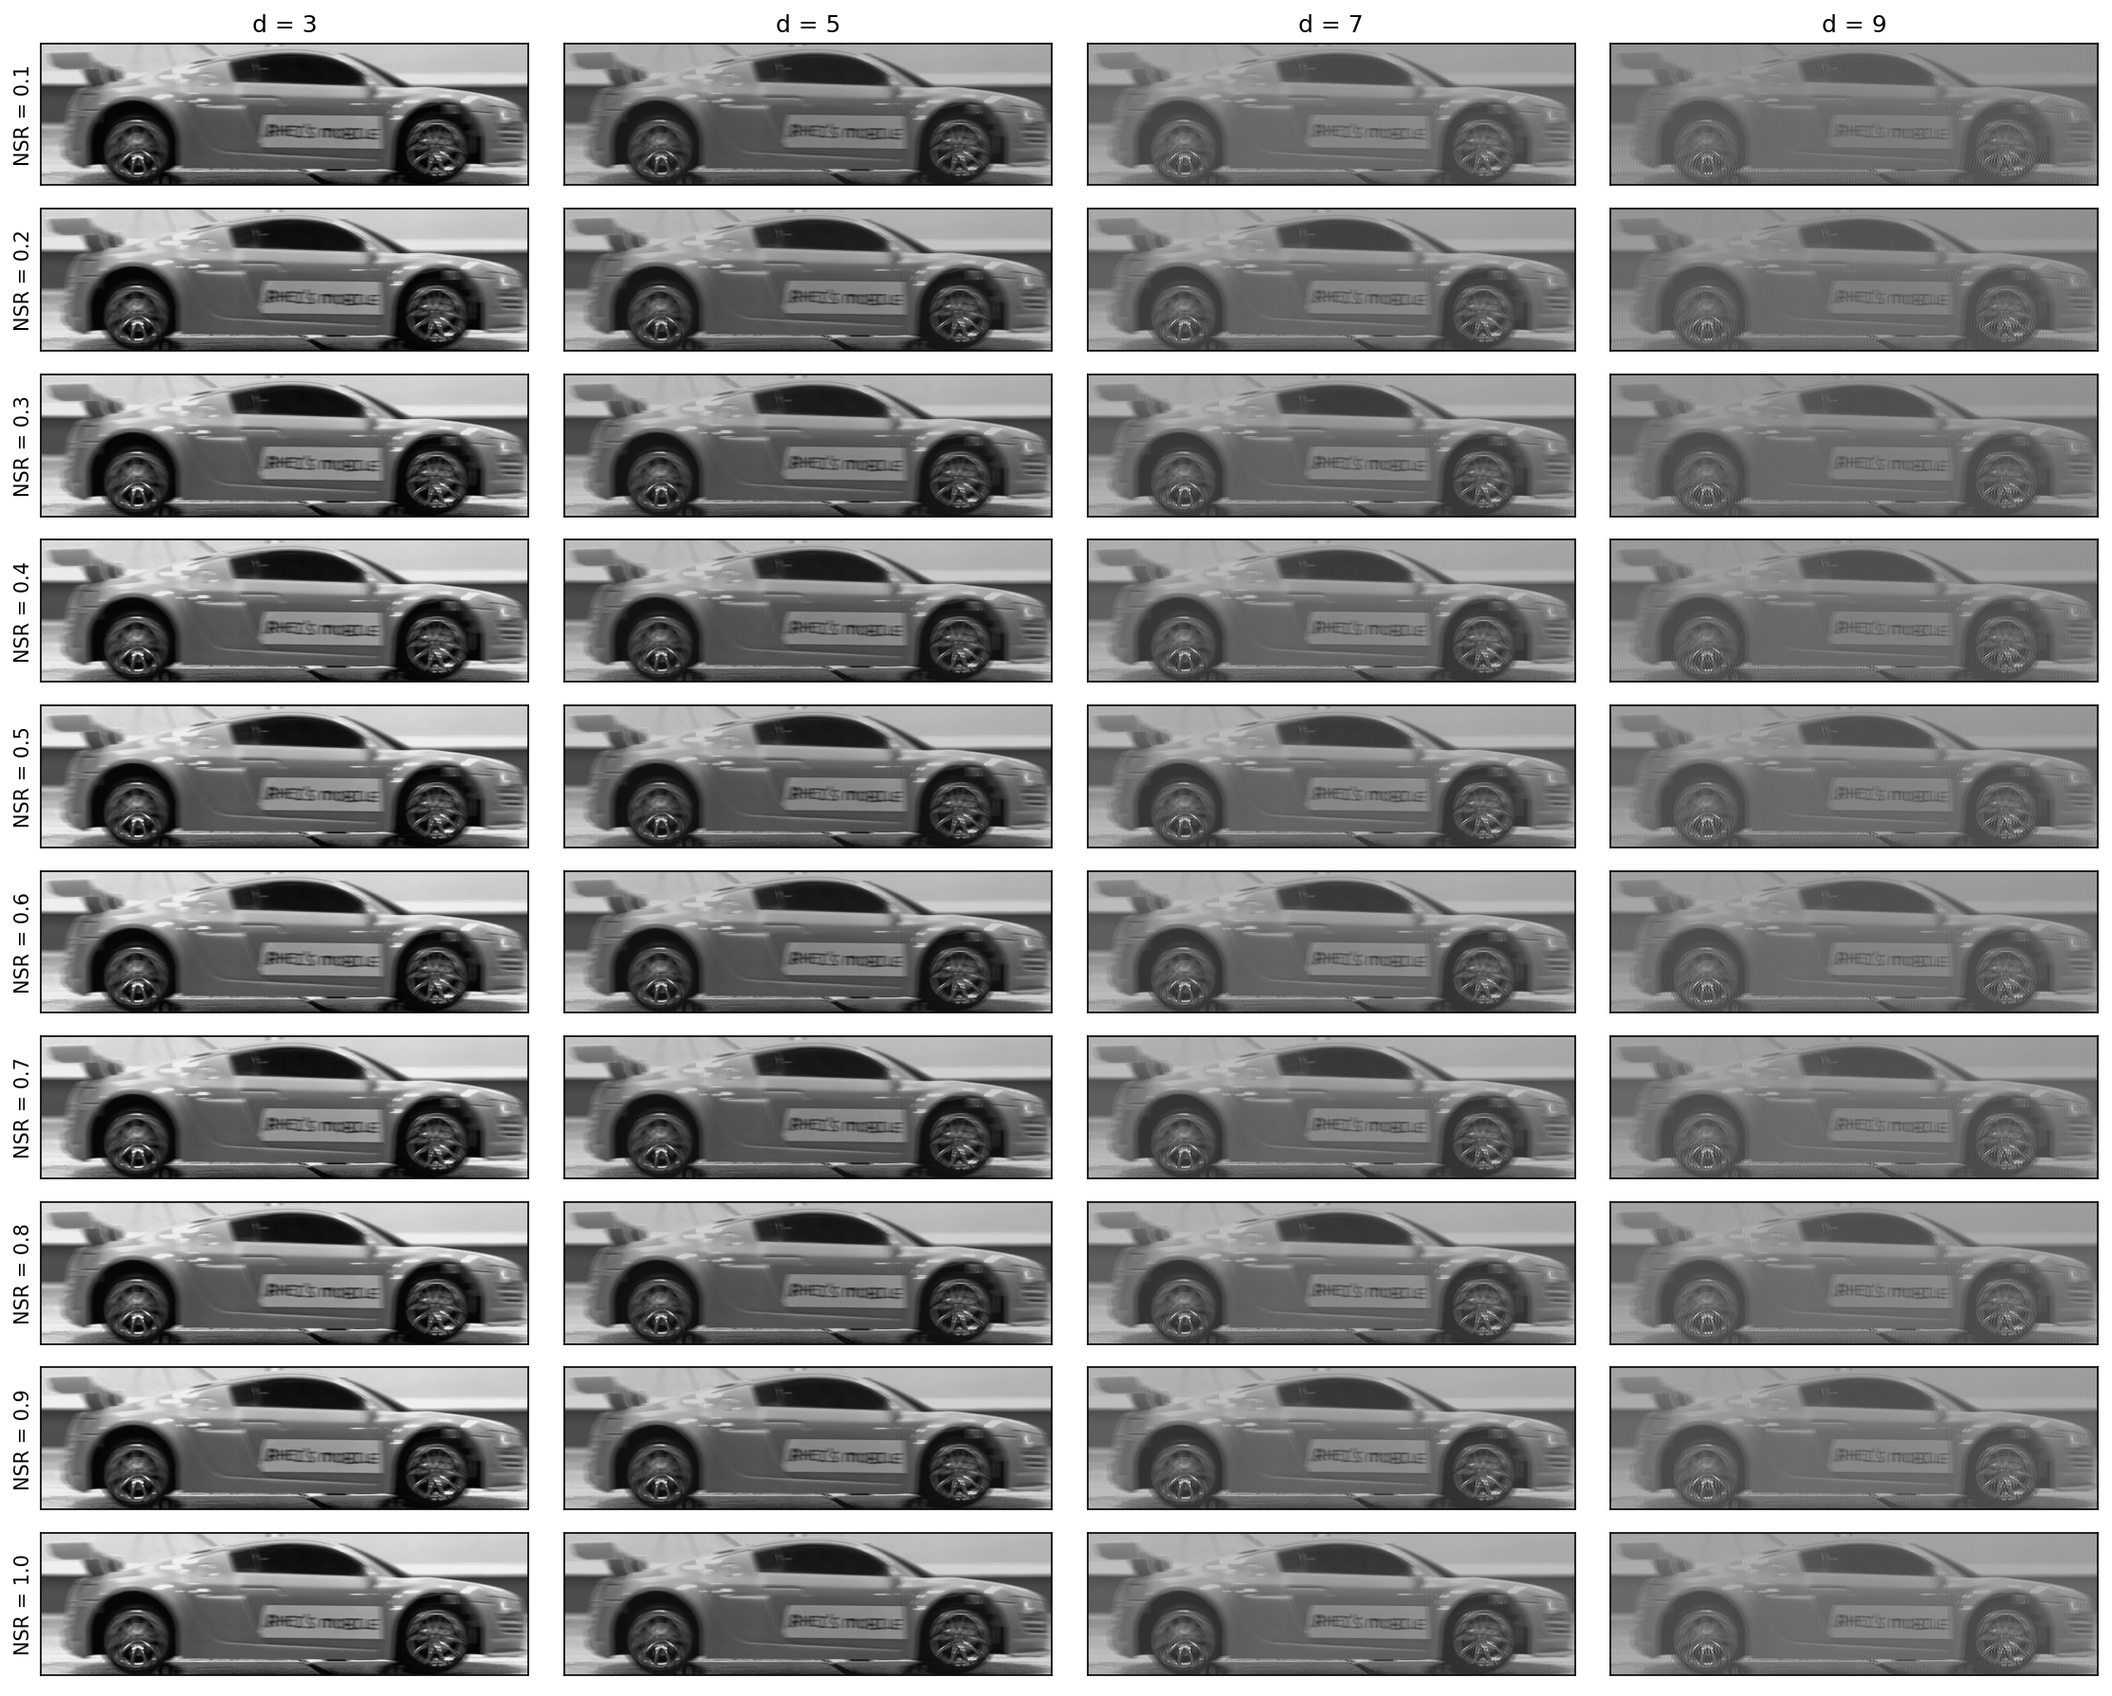

Slide 17
Experimental Results

Slide 18
reflection
My personal research background in image processing helped me a lot in doing this activity with ease. Some of the results presented in this report were recreations of what I did in my Applied Physics 186 – Color Segmentation report. I believe I was able to deliver a sufficient output and explained the nuances in the results using segmentation techniques. By showcasing practical applications in art and biomechanics, the strengths and limitations of the technique were generalized. I thoroughly enjoyed accomplishing this activity.
With that said, I’d give myself a score of 100/100.
[1] M. Soriano, Applied Physics 186 - Image Segmentation, (2019).
[2] M. Soriano, Physics 301 - Color Segmentation, (2022).
[3] https://www.hki.fitzmuseum.cam.ac.uk/projects/cracks
[4] https://ustynazimnyfruzynska.blogspot.com/2019/03/gambar-hd-lukisan.html
M. Bartolome, Activity #7 – Image Segmentation, (2015). https://barteezy.wordpress.com/2015/10/05/activity-7-image-segmentationo/
https://rlprincipe.wixsite.com/reneprincipejr/post/image-segmentation

